Slide 1




GROUP 13
NUMERO SADA FUTSAL
MOBILE APPLICATION AND WEBSITE
D3 OF INFORMATION TECHNOLOGY BY GROUP 13

Slide 2
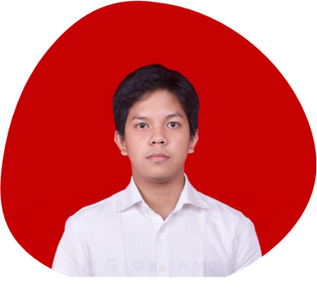
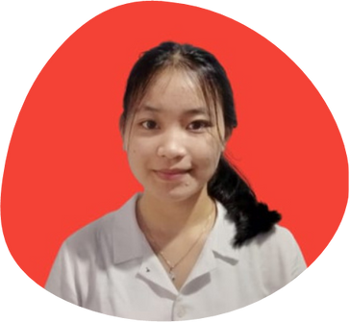
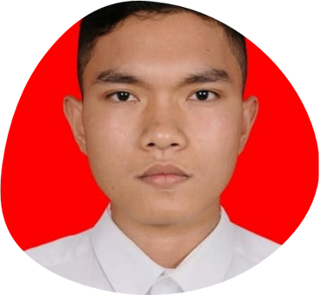


OUR TEAM
GROUP 13
Gabriel Sigalingging
Emy Sinambela
Bennedict Tambunan
Suandika Napitupulu
11321003
11321023
11321032
11321043

Slide 3

GROUP 13
01
INTRODUCTION
02
CURRENT SYSTEM
OUTLINE
03
TARGET SYSTEM
04
MAIN FUNCTION
05
USECASE DIAGRAM AND USECASE SCENARIO
06
ER DIAGRAM, CDM AND PDM
07
CLASS DIAGRAM
08
SEQUENCE DIAGRAM
09
DEMO

Slide 4

INTRODUCTION
GROUP 13
In the Balige area there is a business called Numero Sada Futsal. This place is the only futsal field booking place in the Toba area that is visited by visitors, besides being able to book a futsal field, this place also has a cafe called Foodpedia. However, Numero Sada Futsal often has problems when customers book futsal courts via WhatsApp / telephone. With the existence of an application, it is hoped that it can make it easier for Numero Sada Futsal and customers to book the field with the DP system and customers can find out information about the food and beverage menu available at Foodpedia.

Slide 5


CURRENT SYSTEM
GROUP 13
Numero Sada Futsal is a place in Lumban Julu, Balige, where you can play futsal and enjoy delicious food. They have two ways to order their futsal courts and dishes.
The first way is for customers to visit Numero Sada Futsal in person and order the futsal court and food according to their preferences and requirements.
The second way is for customers to contact Numero Sada Futsal through WhatsApp or phone in advance. They can book the futsal court, inquire about the menu, and ask for prices. Once the booking is approved, customers are requested to arrive within 30 minutes; otherwise, the order will be canceled.
Numero Sada Futsal is facing a problem with their current ordering system, which is not efficient and often leads to long queues, especially during peak times. The main issue is that they still rely on a manual ordering process. This causes difficulties for customers who want to book futsal courts at specific times because there is no system to monitor the availability of the courts.
Additionally, the process of booking via WhatsApp also has its challenges. Numero Sada Futsal does not ask for a down payment (DP) in advance, which means that if they are unable to contact the customer, it can result in financial losses for the futsal center.

Slide 6
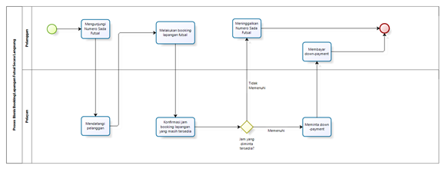
CURRENT SYSTEM
GROUP 13
BPMN Direct Field Booking

Slide 7
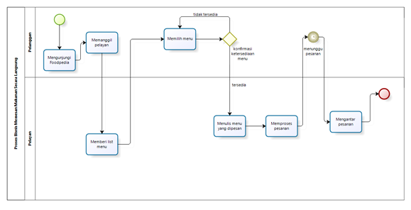
CURRENT SYSTEM
GROUP 13
2. BPMN Ordering Food Directly

Slide 8
Numero Sada Futsal has developed a mobile application and a website using two platforms. The admin side is based on the website, while the customer side is based on the mobile app. The purpose of these applications is to provide customers with online access to information about the futsal courts and menu options, as well as to make it easier for them to book courts and order food through the provided app.
The development of these applications aims to address the current challenges. It aims to minimize the possibility of customers not getting a court due to overcrowding at Numero Sada Futsal. The application also offers a down payment system for payment, which helps to avoid losses for Numero Sada Futsal.
To use this application, customers need to register an account and login after their account is successfully registered. The goal of the system at Numero Sada Futsal is to allow customers to easily book courts and order food using the mobile app, while the admin can manage information and confirm orders through the website.
TARGET SYSTEM
GROUP 13

Slide 9
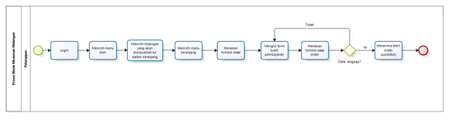
BPMN Book a Futsal Field
TARGET SYSTEM
GROUP 13

Slide 10
MAIN FUNCTION
GROUP 13
1) Registration function
2) Login function
3) Futsal field booking function
4) The function of ordering dishes
5) Function of managing the dish menu
6) The function of managing field data
7) Field booking confirmation function
8) Dish booking confirmation function

Slide 11
MAIN FUNCTION
GROUP 13
9) Add event function
10) Event delete function
11) User data editing function
12) User delete function
13) Cart editing function
14) Cart deleting function
15) Cancel meal order function
16) Information viewing function
17) Logout function

Slide 12
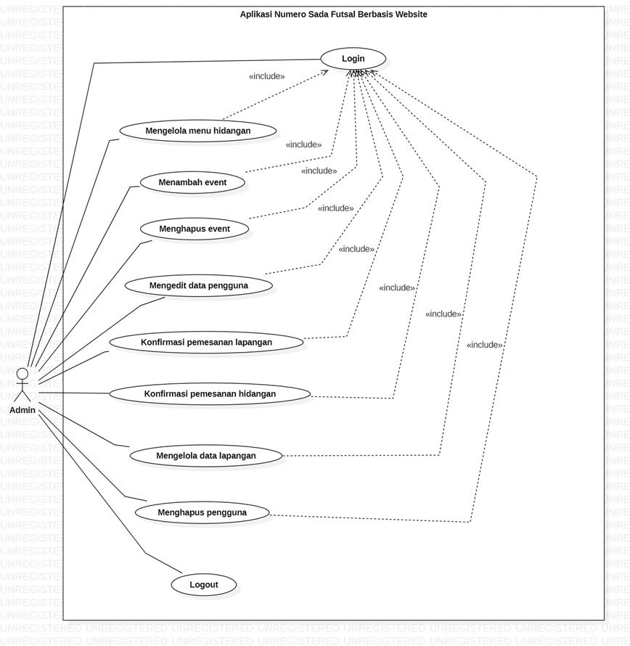

USECASE DIAGRAM
GROUP 13
FOR WEBSITE

Slide 13
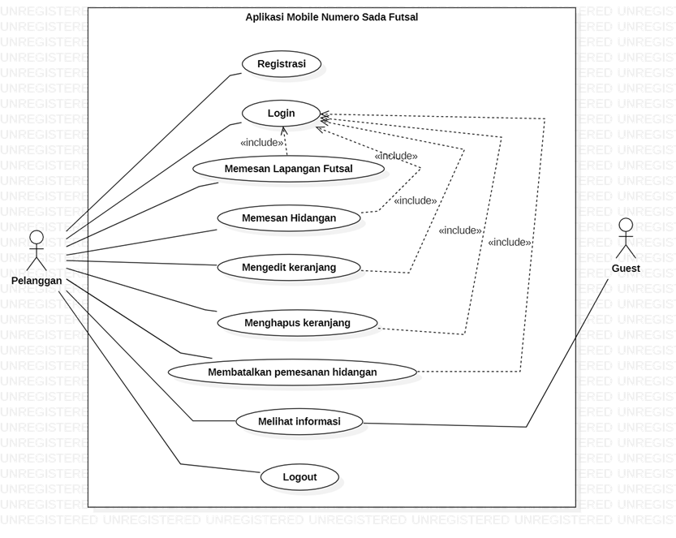
USECASE DIAGRAM
GROUP 13
FOR MOBILE

Slide 14
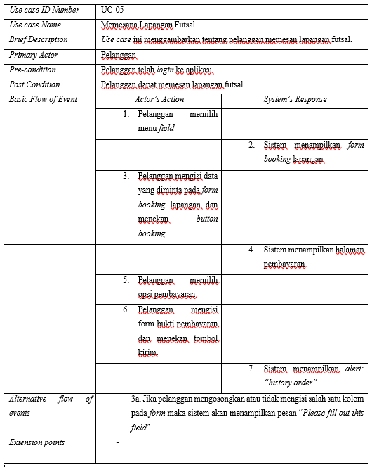
USECASE SCENARIO
GROUP 13
Use Case Scenario of booking a futsal field

Slide 15
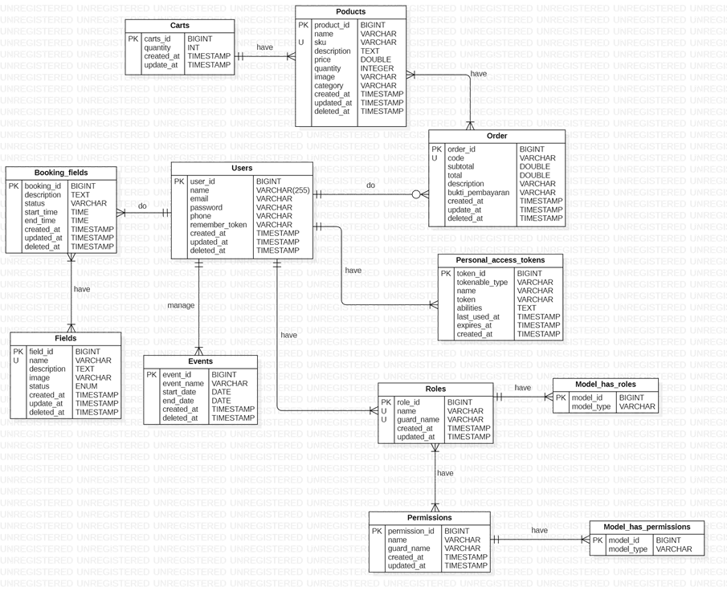
ER-DIAGRAM
GROUP 13

Slide 16

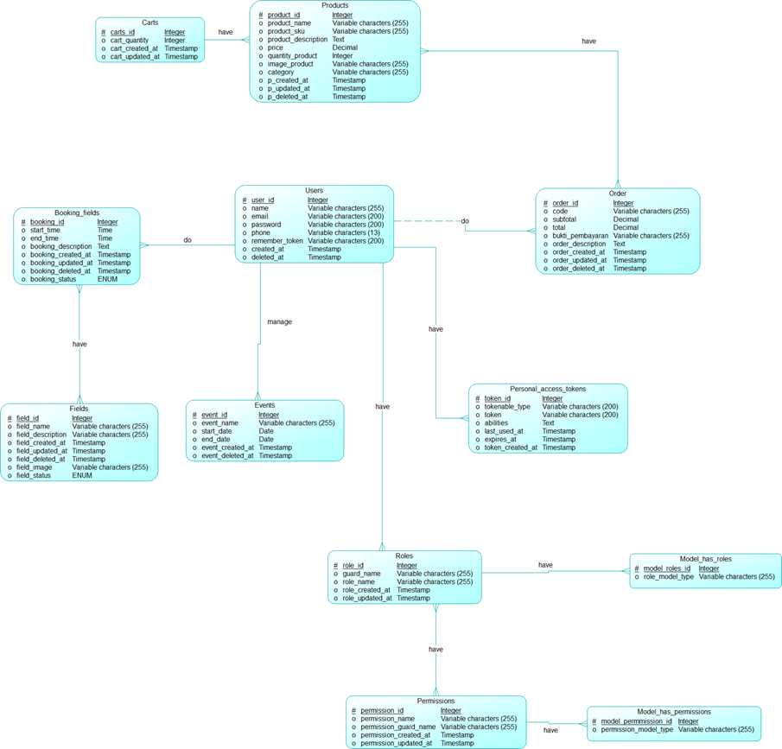
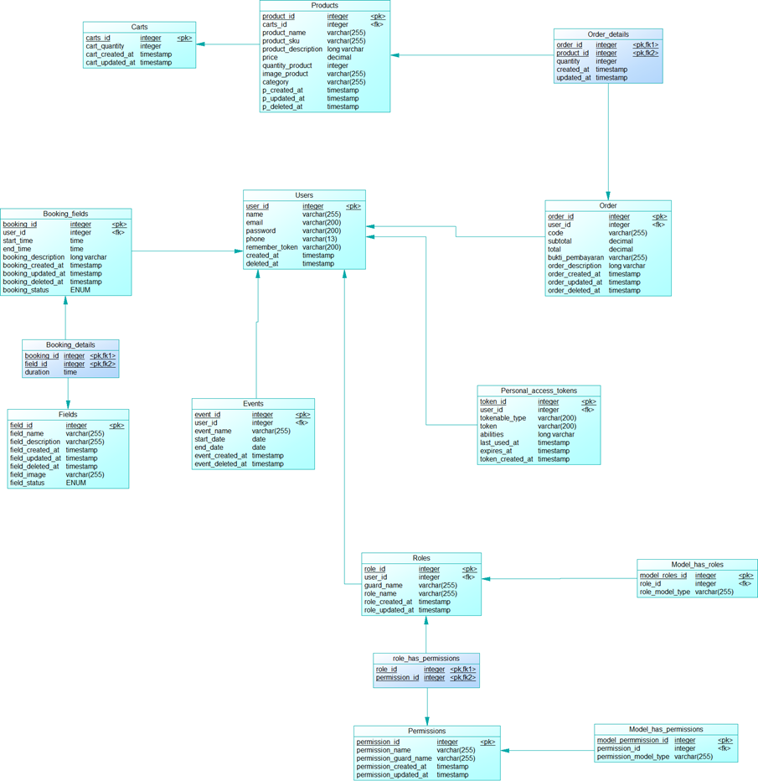
CONCEPTUAL DATA MODEL
PHYSICAL DATA MODEL
GROUP 13

Slide 17

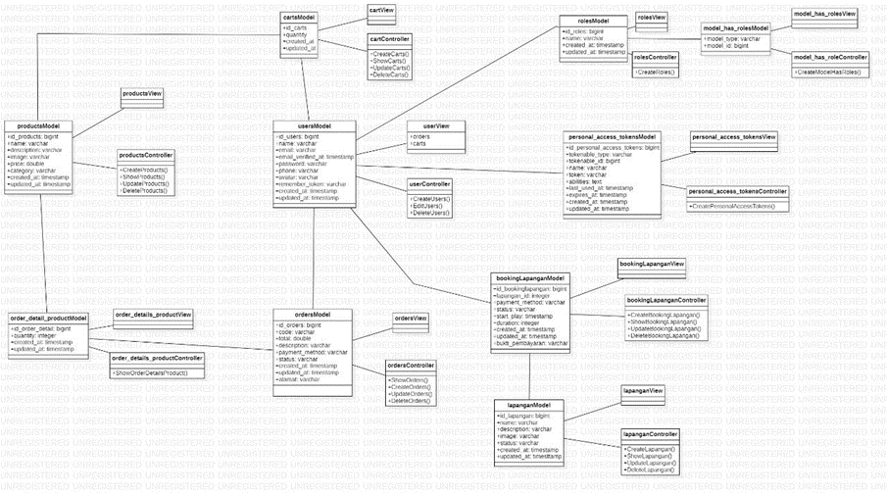
CLASS DIAGRAM
GROUP 13

Slide 18
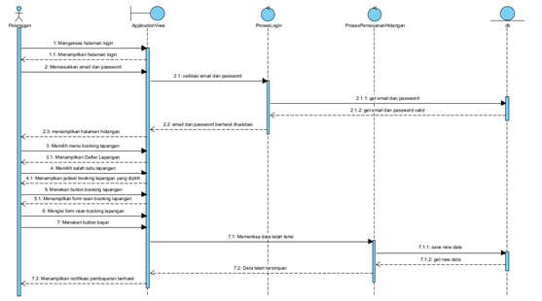
SEQUENCE DIAGRAM
GROUP 13
Sequence Diagram of booking a futsal field

Slide 19

GROUP 13
DEMO

Slide 20
GROUP 13
THANK YOU

